Slide 1

Housing Price Predication & Analysis Project
By Mr. CHIRAG PATIL
Fliprobo SME – Khushboo Garg

Slide 2
Problem Statement
A US-based housing company named Surprise Housing has decided to enter the Australian market. The company uses data analytics to purchase houses at a price below their actual values and flip them at a higher price. For the same purpose, the company has collected a data set from the sale of houses in Australia.
It is required to build a model using Machine Learning in order to predict the actual value of the prospective properties and decide whether to invest in them or not.

Slide 3
For this company wants to know:
Which variables are important to predict the price of variable?
How do these variables describe the price of the house?
How to construct a realistic model to precisely predict the price of real estate has been a challenging topic with great potential for further research.
Our main objective of doing this project is to build a model to predict the house prices with the help of other supporting features

Slide 4
Conceptual Background
There are many factors that have an impact on house prices, such as the number of bedrooms and bathrooms. House price depends upon its location as well. A house with great accessibility to highways, schools, malls, employment opportunities, would have a greater price as compared to a house with no such accessibility.
The study answers the following research questions:
- Research question 1: Which machine learning algorithm performs better and has the most accurate result in house price prediction? And why?
- Research question 2: What are the factors that have affected house prices in Australia over the years?

Slide 5
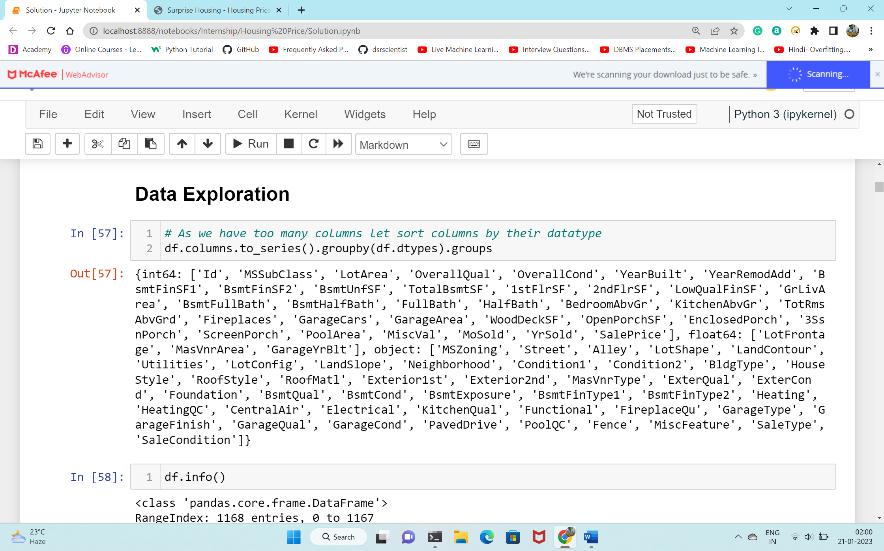
Data Sources and their formats
Data set provided by Flip Robo was in the format of CSV (Comma Separated Values). There are 2 data sets that are given. One is training data and one is testing data.
1) Train file will be used for training the model, i.e., the model will learn from this file. The dimension of data is 1168 rows and 81 columns.
2) Test file contains all the independent variables, but not the target variable. The dimension of data is 292 rows and 80 columns.

Slide 6
Project Steps and Task Flow
Data Integrity Check For presence of duplicate or any data error.
Missing values present in data set. Features containing more than 40% missing value are drop from investigation.
Imputation of missing value with median and mode is performed.
Feature Engineering
Feature selection
Label Encoding of Categorical features
Splitting of dataset into Input & target feature
Feature Scaling in Train and Test

Slide 7
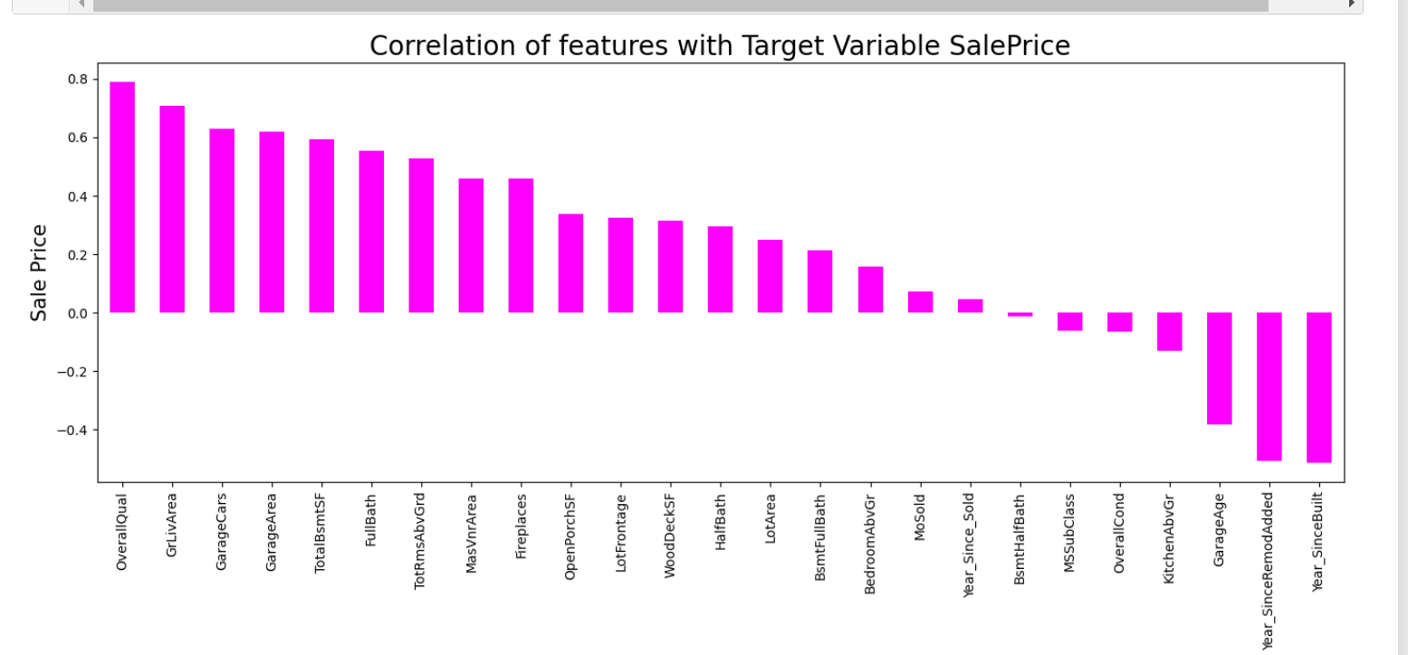
Correlation of Features

Slide 8
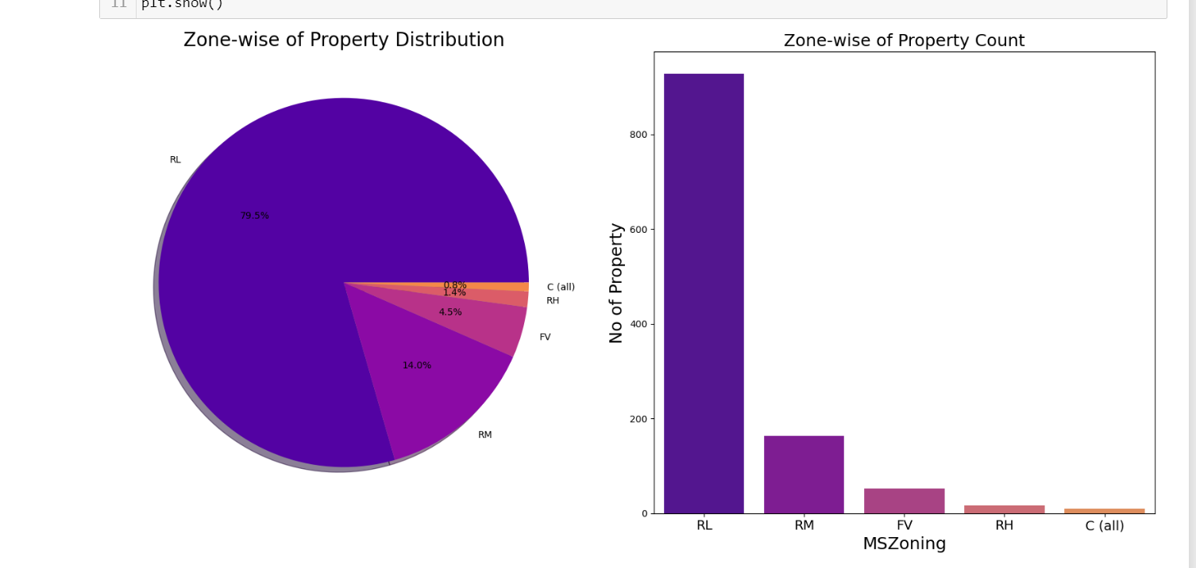
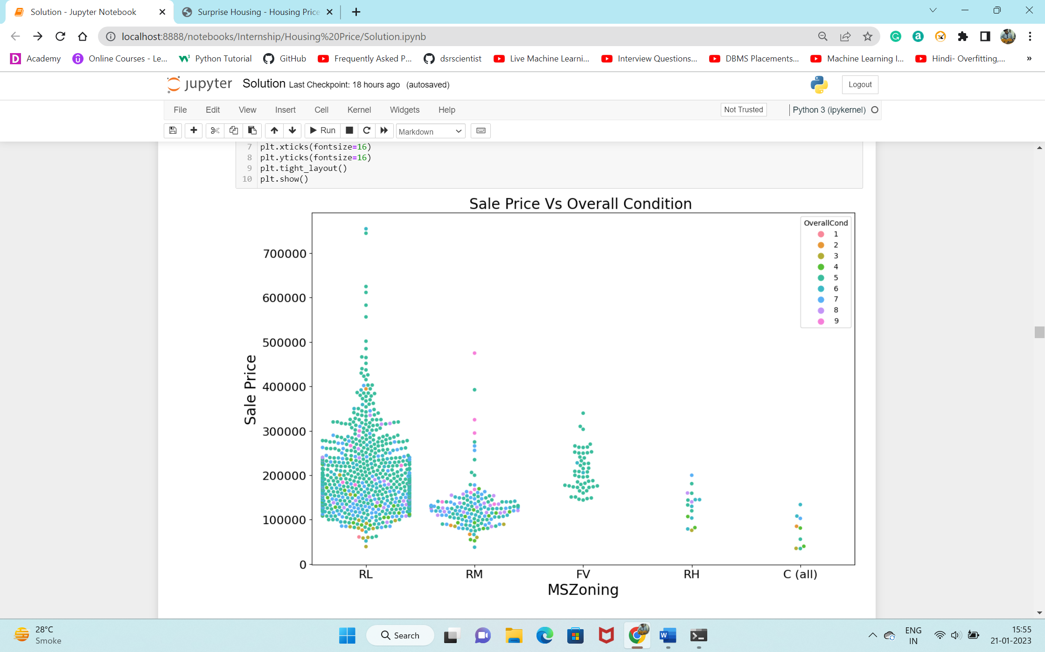
Exploratory Data Analysis(EDA)
79.5% of House properties belongs to Low Density Residential Area followed by 14 % of properties belong to Medium Density Residential Area.
Most of property for sale have overall condition rating of either 5 or 6.
We already know of 80% of housing data belongs to Low density Residential Area and Now we can see in Swarm Plot that Sale Price inside RL Zone is much higher than another remaining zone

Slide 9
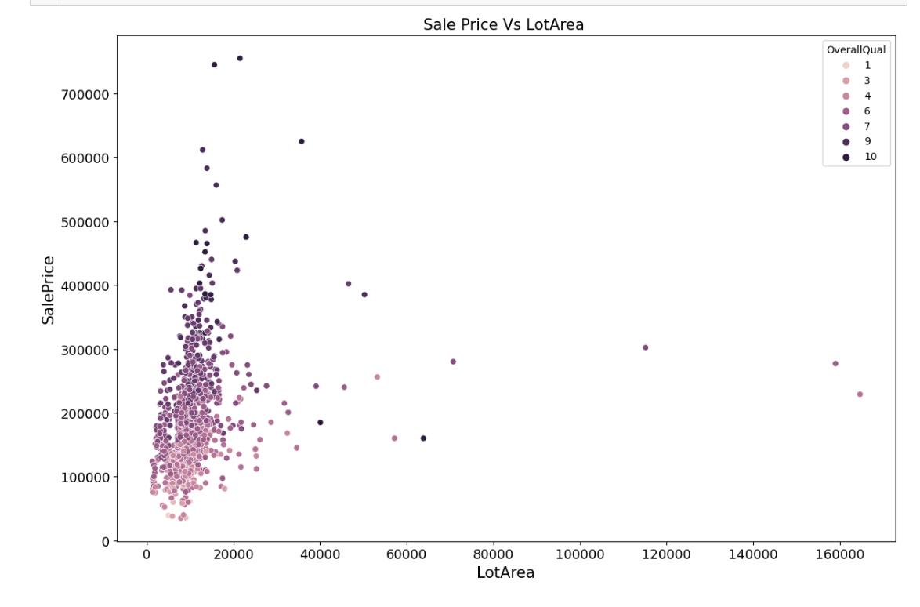
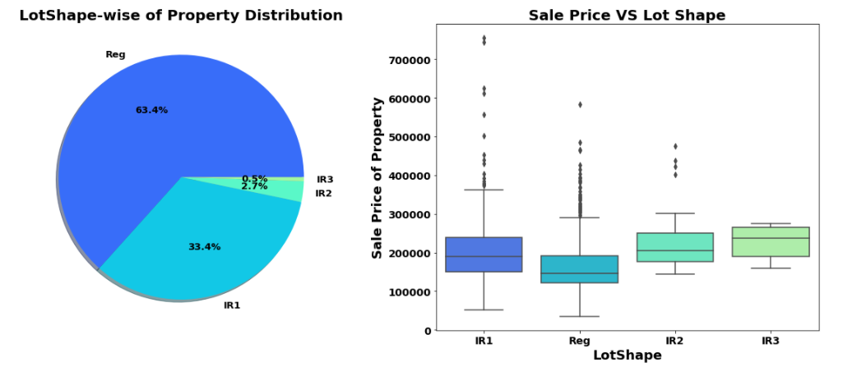
There is No Significant relationship found between Sale price & Lot area.
63.4% house properties are regular in shape.
Sale Price of property with slight irregular shape is higher than regular shape.

Slide 10
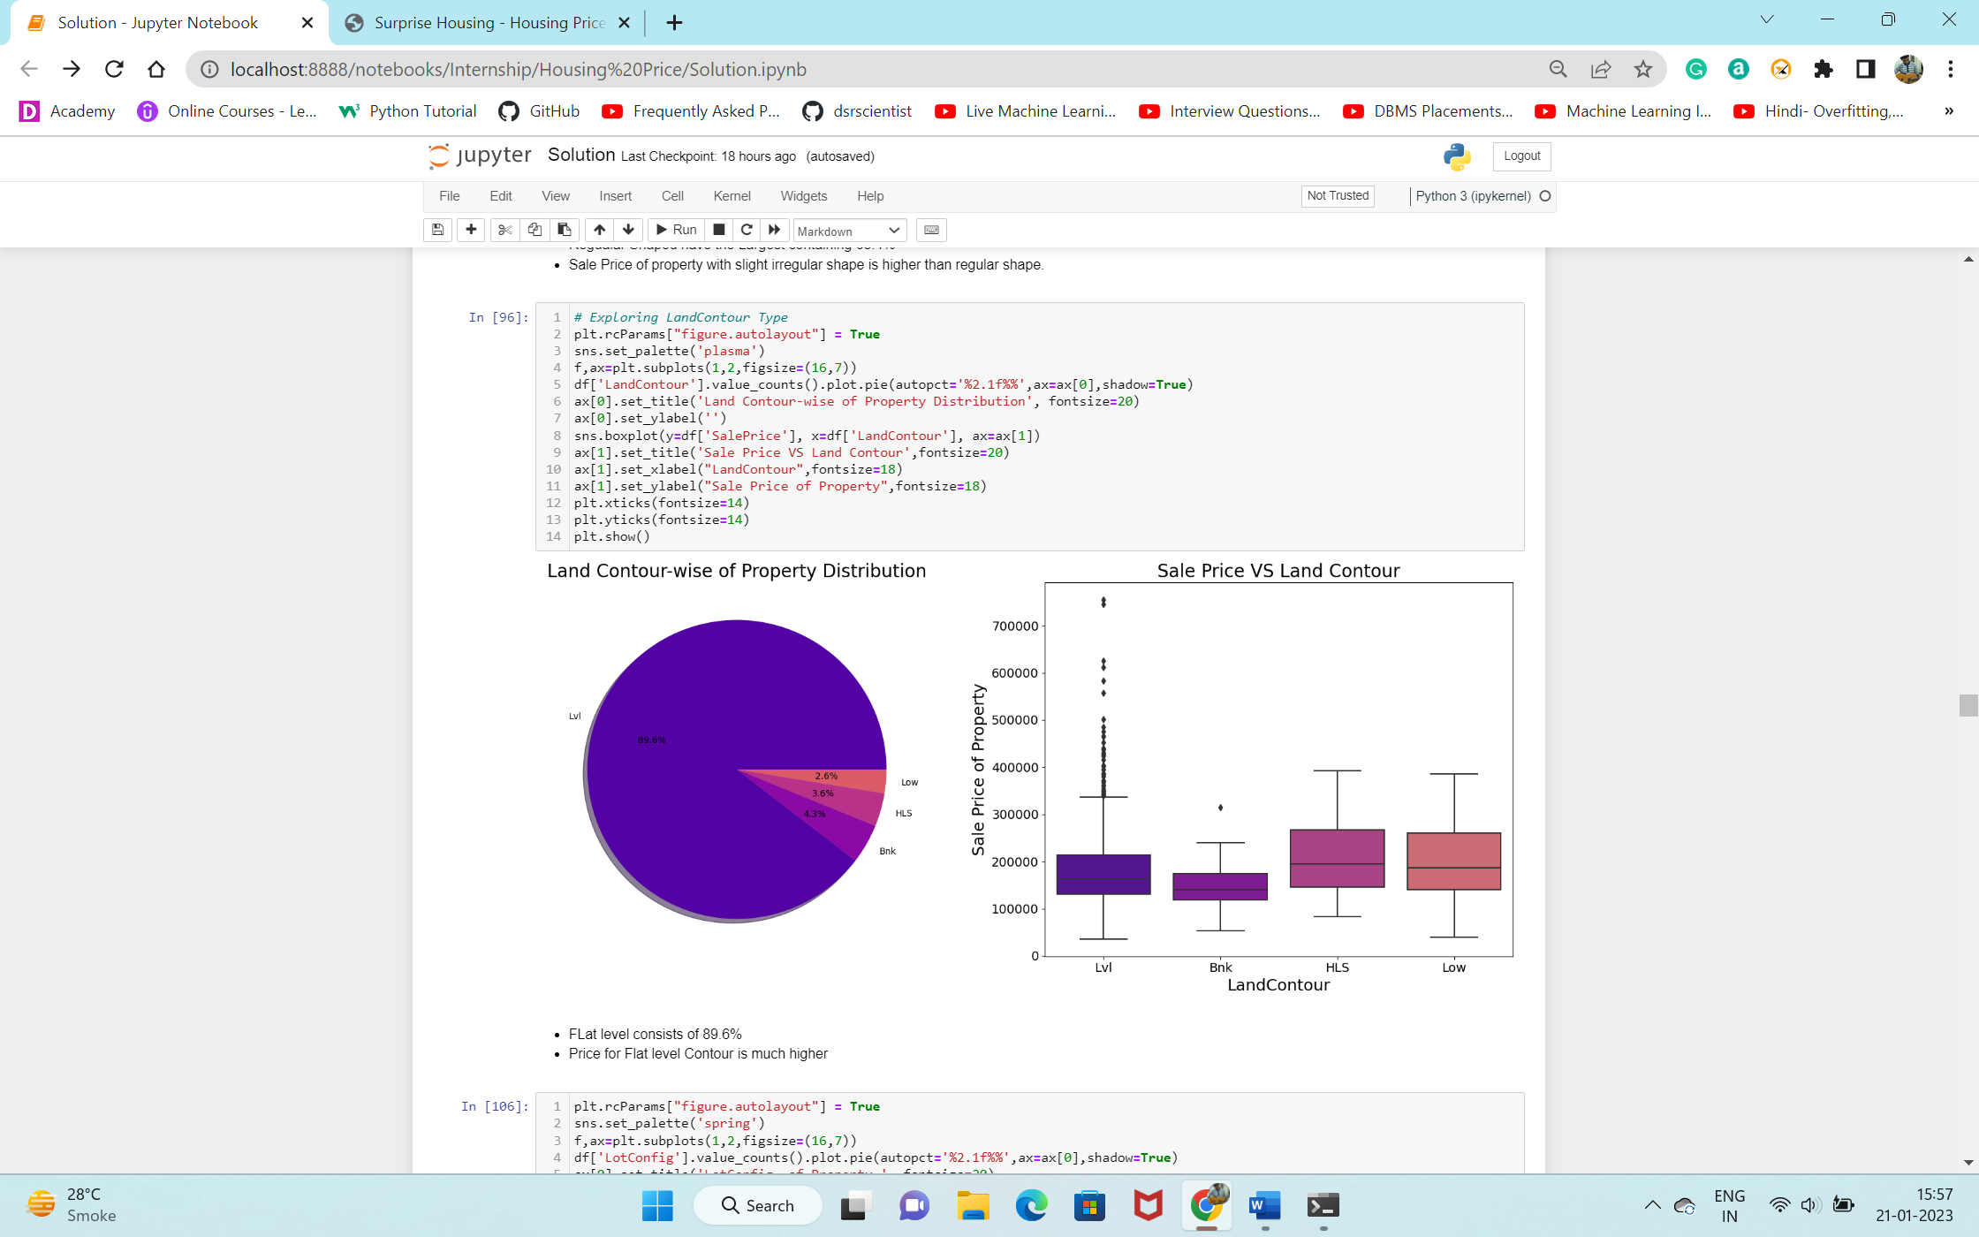
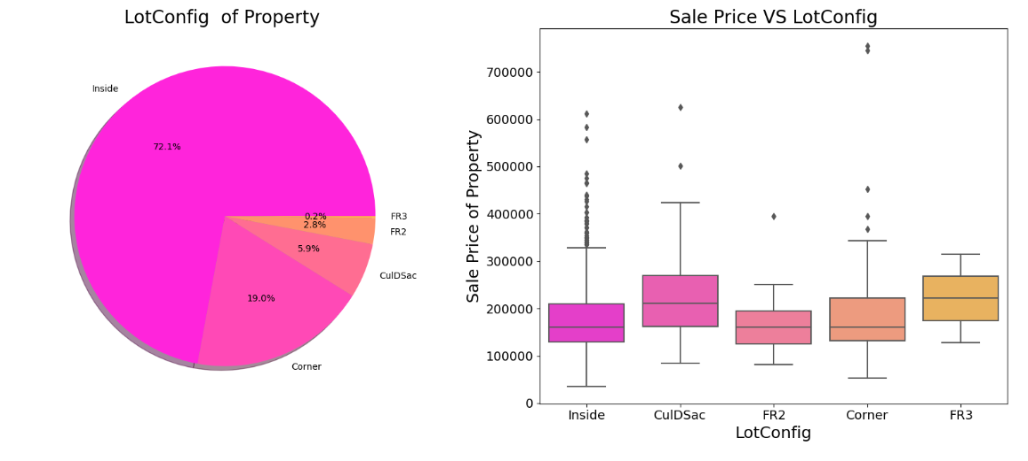
89.6% of House properties are near flat level surface.
Also, price for Flat level surface house is much higher than other land contour.
Around 72 % of house comes with inside Lot configuration.
Cul-de-sac has maximum Mean Sale Price among all lot configuration.
Cheapest Houses belong to Inside lot configuration while Costlier houses belongs to Corner Lot Configuration.

Slide 11
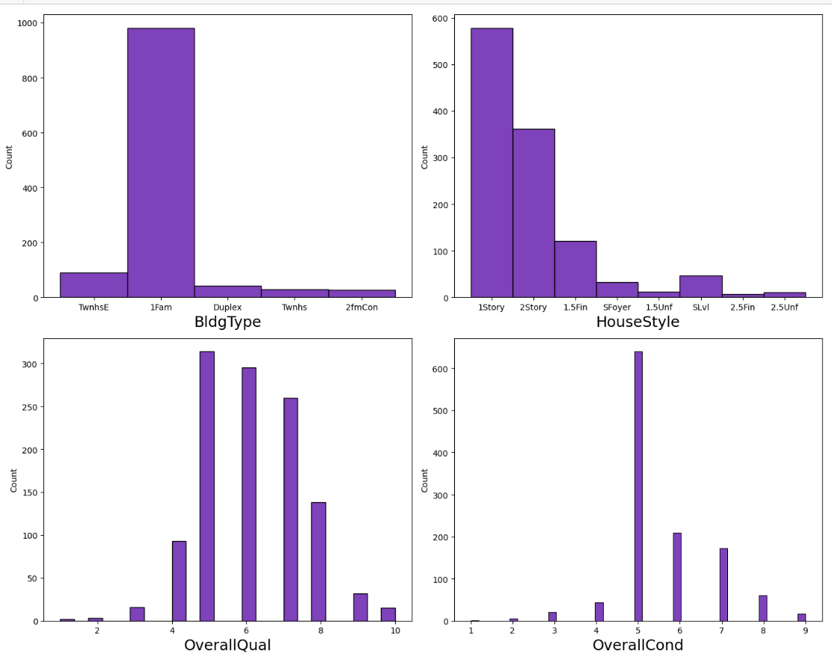
More than 950 house properties are with building type Single-family Detached.
More than 50% of house properties comes with Overall Condition Rating of 5.
More than 75% of house properties come with overall Quality Rating varies between 5 to 6.
More than 500 House Properties comes with one story dwelling.

Slide 12
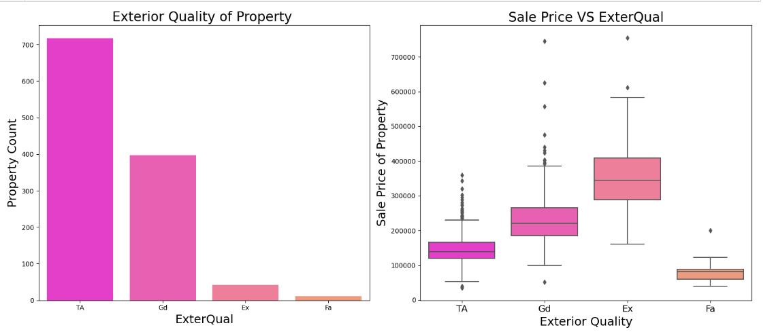
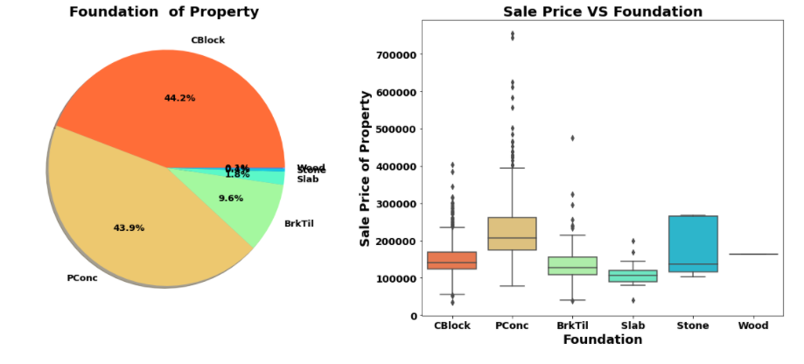
Around 60% of house properties come with Average Exterior quality and all of them below 400000.
Very few House Properties comes with Excellent Exterior Quality.
Costlier house properties come with Good & Excellent exterior quality.
44.2% Properties with CBlock Foundation & 43.9% housing property come with PConc Foundation.
Pconc Foundation are mostly use in costly housing properties.

Slide 13
Machine Learning Algorithms
The different regression algorithm used in this project to build ML model are as below:
Linear Regression
Random Forest Regressor
Decision Tree Regressor
Extra Tree Regressor

